Slide 1
2-3 Trees

Slide 2
Contents
Introduction
The 2-3 Trees Rules
The Advantage of 2-3 Trees
Searching For an Item in a 2-3 Tree
Inserting an Item into a 2-3 Tree
Removing an Item from a 2-3 Tree

Slide 3
INTRODUCTION
What Is a 2-3 Tree?
Definition: A 2-3 tree is a tree in which each internal node(nonleaf) has either 2 or 3 children, and all leaves are at the same level.

Slide 4
2-3 Trees
a node may contain 1 or 2 keys
all leaf nodes are at the same depth
all non-leaf nodes (except the root) have either 1 key and two subtrees, or 2 keys and three subtrees
insertion is at the leaf: if the leaf overflows, split it into two leaves, insert them into the parent, which may also overflow
deletion is at the leaf: if the leaf underflows (has no items), merge it with a sibling, removing a value and subtree from the parent, which may also underflow
the only changes in depth are when the root splits or underflows

Slide 5
A 2-3 Tree of height 3

Slide 6
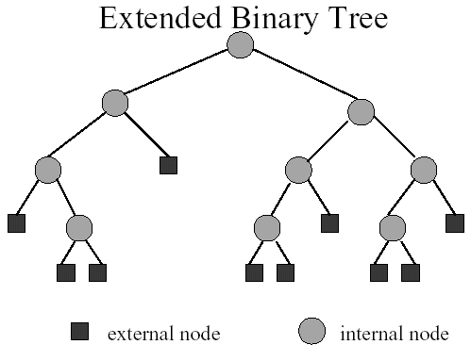

Slide 7
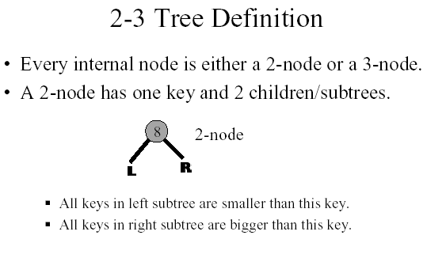

Slide 8
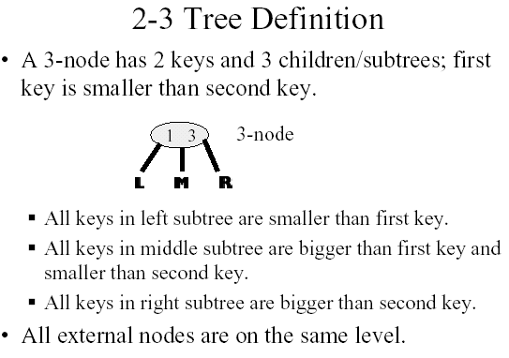

Slide 9
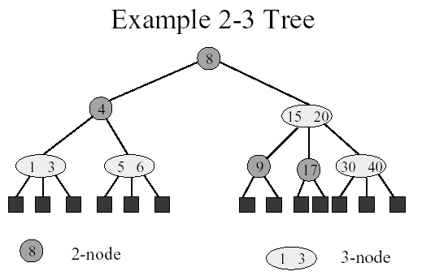

Slide 10
2-3 Tree vs. Binary Tree
A 2-3 tree is not a binary tree since a node in the 2-3 tree can have three children.
A 2-3 tree does resemble a full binary tree.
If a 2-3 tree does not contain 3-nodes, it is like a full binary tree since all its internal nodes have two children and all its leaves are at the same level.

Slide 11
Cont.
If a 2-3 tree does have three children, the tree will contain more nodes than a full binary tree of the same height.
Therefore, a 2-3 tree of height h has at least 2^h - 1 nodes.
In other words, a 2-3 tree with N nodes never has height greater then log (N+1), the minimum height of a binary tree with N nodes.

Slide 12
Example of a 2-3 Tree
The items in the 2-3 are ordered by their search keys.
50 90
20
70
120 150
10
30 40
60
80
100 110
160

Slide 13
Node Representation of 2-3 Trees
Using a typedef statement
typedef treeNode* ptrType;
struct treeNode
{ treeItemType SmallItem,LargeItem;
ptrType LChildPtr, MChildPtr,
RChildPtr;
};

Slide 14
Node Representation of 2-3 Tree (cont.)
When a node contains only one data item, you can place it in Small-Item and use LChildPtr and MChildPtr to point to the node’s children.
To be safe, you can place NULL in RChildPtr.

Slide 15
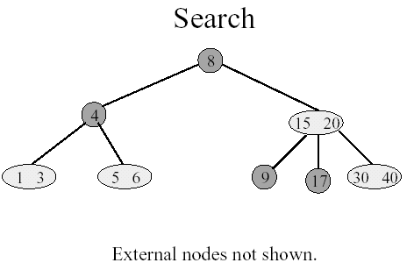

Slide 16
The Advantages of the 2-3 trees
Even though searching a 2-3 tree is not more efficient than searching a binary search tree, by allowing the node of a 2-3 tree to have three children, a 2-3 tree might be shorter than the shortest possible binary search tree.
Maintaining the balance of a 2-3 tree is relatively simple than maintaining the balance of a binary search tree .

Slide 17
Consider the two trees contain the same data items.
50
60
30
90
30
70 90
10
50
80
100
10 20
40
60
80
100
20
40
70
A balanced binary search tree
A 2-3 tree

Slide 18
Inserting into a 2-3 Tree
Perform a sequence of insertions on a 2-3 tree is more easilier to maintain the balance than in binary search tree.
Example:

Slide 19
60
30
90
30
50
80
100
20
40
70
39
38
37
36
35
1) The binary search tree after a sequence of
insertions
34

Slide 20
37
34
50
30
35
39
70 90
10 20
36
38
40
60
80
100
2) The 2-3 tree after the same insertions.

Slide 21
Inserting into a 2-3 Tree (cont.)
Insert 39. The search for 39 terminates at the leaf <40>. Since this node contains only one item, can siply inser the new item into this node
50
30
70 90
10 20
39
40
60
80
100

Slide 22
Inserting into a 2-3 Tree (cont.)
Insert 38: The search terminates at <39 40>. Since a node cannot have three values, we divide these three values into smallest(38), middle(39), and largest(40) values. Now, we move the (39) up to the node’s parent.
30
39
10 20
38
40

Slide 23
Inserting into a 2-3 Tree (cont.)
Insert 37: It’s easy since 37 belongs in a leaf that currently contains only one values, 38.
30 39
10 20
37
38
40

Slide 24
The Insertion Algorithm
To insert an item I into a 2-3 tree, first locate the leaf at which the search for I would terminate.
Insert the new item I into the leaf.
If the leaf now contains only two items, you are done. If the leaf contains three items, you must split it.

Slide 25
The Insertion Algorithm (cont.)
Spliting a leaf
a)
P
M P
S M L
S
L
b)
P
P M
S M L
S
L

Slide 26
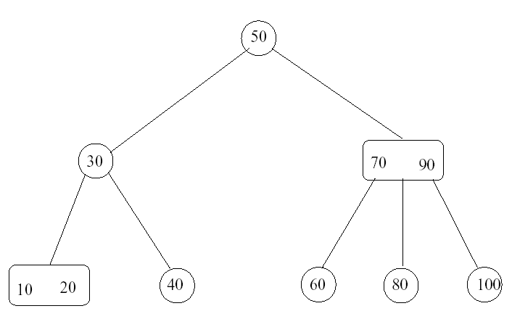
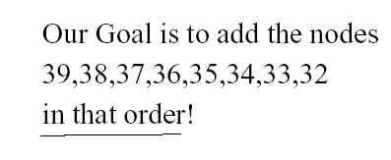

Slide 27
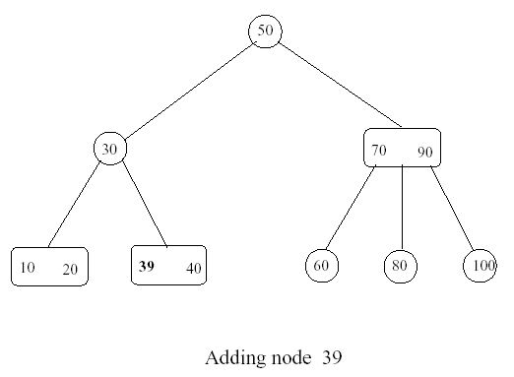
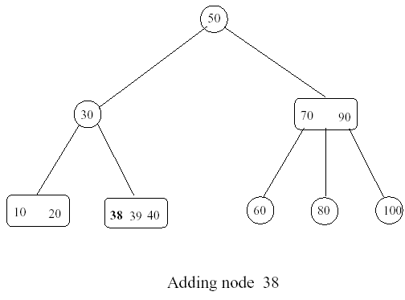

Slide 28
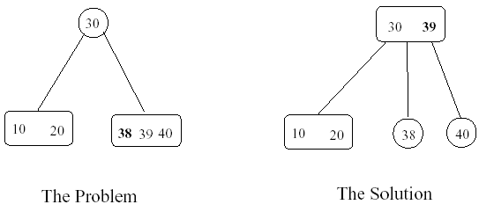
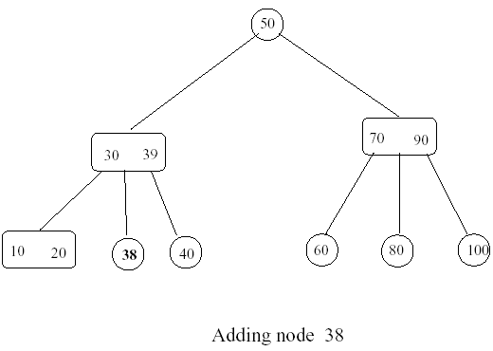

Slide 29
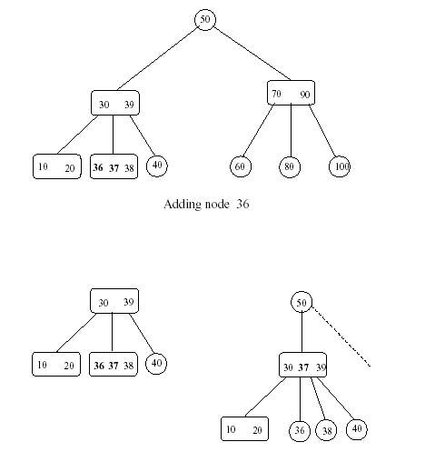

Slide 30
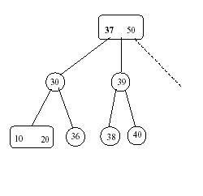
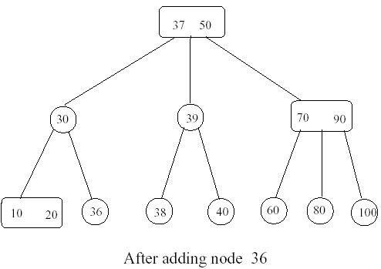

Slide 31
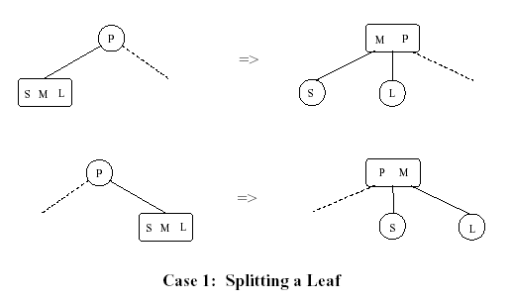

Slide 32
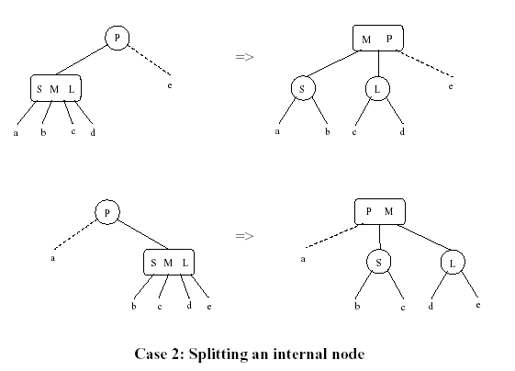

Slide 33
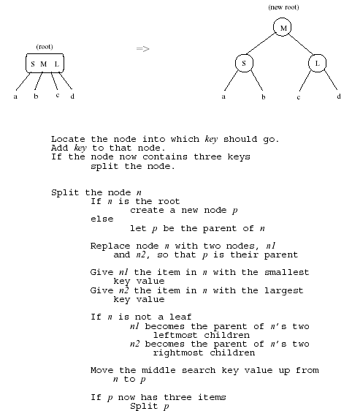

Slide 34
Deleting from a 2-3 Tree
The deletion strategy for a 2-3 tree is the inverse of its insertion strategy. Just as a 2-3 tree spreads insertions throughout the tree by splitting nodes when they become too full, it spreads deletions throughout the tree by merging nodes when they become empty.
Example:

Slide 35
Deleting from a 2-3 Tree (cont.)
Delete 70
80 90
80 90
60
70
100
60
-
100
Swap with inorder successor
Delete value from leaf
80 90
90
60
100
60 80
100
Merge nodes by deleting empty leaf and moving 80 down

Slide 36
Deleting from 2-3 Tree (cont.)
Delete 70
50
30
90
40
60 80
100
10 20

Slide 37
Deleting from 2-3 Tree (cont.)
Delete 100
90
90
80
60 80
--
60
80
60
90
60 80
Delete value from leaf
Doesn’t work
Redistribute

